Slide 1
2026-2027
Program Planning Kick-off & Training
Notes:
Welcome to the Program Planning Kick-off and Training.
Introduce Self.

Slide 2

Net Promoter Scores
2025 In Review
15,208 Youth Served
3,902 Cub Scouts
2,537 Scouts BSA
24 Venturing
25 Sea Scouts
245 Exploring
267 Scouting Units
119 Packs
129 Troops
9 Crews
2 Ships
10 Posts
2,754 Volunteers
211 Eagle Scouts
2,348 Summer Camp
Attendees
Notes:
We are going to start by taking a look at 2025.
As you can see, 2025 was a good year for the Greater Alabama Council. In 2025, our Council provided programming to more than 15,000 youth across our 22-county service area. The “Youth Served” numbers above don’t reflect our in-school Learning for Life program participants.
We had more than 2,300 Scouts participate in our Summer Camp programs, served 300 Scouting units, and saw 211 Scouts achieve the rank of Eagle.
Why are we looking at this? This shows that successful units with a good program and financial plan retain Scouts and deliver a high-quality program. This is a solid foundation we can build upon for 2026 and beyond!

Slide 3
How does our unit move forward?
Successful Units that attract and keep Scouts:
Have leadership that is helpful, friendly, kind, trained, organized, and provide good communication.
Have a strong annual program plan that is FUN!
Ensure all Scouts and their families feel welcome.
Have an easy to explain finance plan that funds the unit expenses AND offers a way for families to subsidize their Scouting journey.
Notes:
Read slide.
This is what Program Planning is all about. Helping unit leaders plan and schedule your next year of program so that they can attract and keep Scouts and families.
A question we all face in Scouting: Why do Scouts and Families Leave Scouting?
#1 reason is Poor Adult Leadership / problems with leaders.
#2 is loss of interest in the program. Scouting is no longer fun.
#3 not feeling welcome.
#4 cost
- Unit leadership problems, a loss of interest, not feeling welcome, and cost are most often mentioned by parents .
- Among youth who have not aged out of the program, other activities, poor leadership, no longer fun, and a loss of interest are the top factors.

Slide 4
Families want to know 2 things:
What are we going to do?
How much is it going to cost?
Notes:
As you begin thinking about your annual plan, recognize that families want to know the answer to 2 things:
- What are we going to do & How much is it going to cost?
If the unit can answer these 2 simple questions, families will sign up and stay involved. It always works!

Slide 5

Annual Program Planning
Notes:
This brings us to Annual Program Planning.
Tonight, we are going to walk you through ideas and best practices to help you improve your unit’s program and funding plan.

Slide 6
THIS IS THE WAY WE’VE ALWAYS DONE IT.
Notes:
Before we get to far, we want to start with this. “This is the way we’ve always done it”
CLICK
Scouting continues to change and grow. All our programs have been updated in the last few years and this includes Cub Scouts, Scouts BSA, Sea Scouting and Venturing. Our Districts and Council have updated events and made changes to better accommodate and support your efforts. Please take advantage of these things.
The costs associated with Scouting have also increased and will continue to increase and you’ll need to adapt your operations accordingly.
We are going to share some great ideas and recommendations, so please have an open mind.

Slide 7
Annual Program Planning
Is an Annual Unit Meeting to:
- Plan and Schedule your next year of program
- Create a Calendar
- Develop your Finance Plan
And Then: Share this with your families
Notes:
Read Slide.
If you have a paper copy, See Pages 4 – 5 in your Planning Calendar.

Slide 8

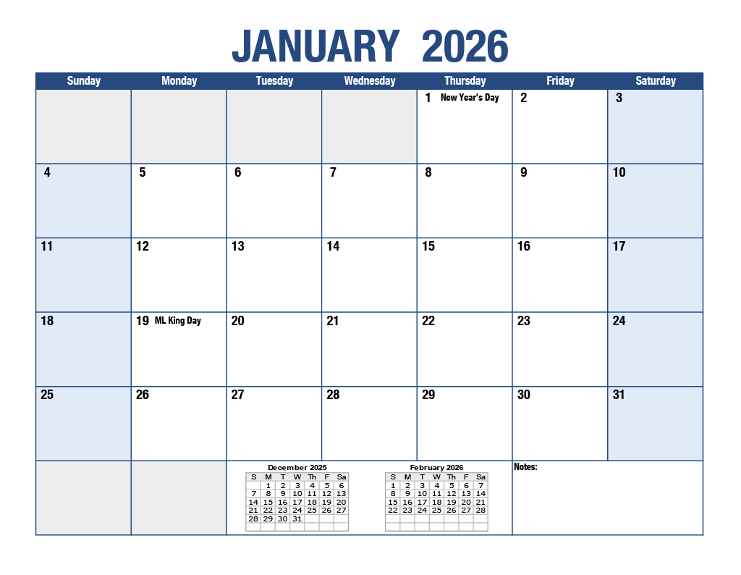
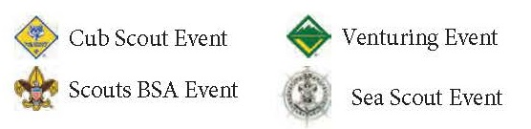
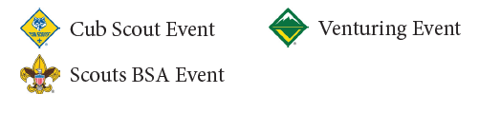
Notes:
The Guidebook is a tool to help you during the process. Specifically at your meeting. We have a couple available for each unit and the file is online on our website for you to print more as needed. It is also designed to be viewed digitally.
The calendar on the left page is intentionally left blank. This is so that you can write down your unit dates and activities.
Council events are in the top right, followed by typical unit events held that month, followed by District events. There are also labels to help you identify Cub Scout Events, Scouts BSA Events, Sea Scouting, and Venturing Events.

Slide 9
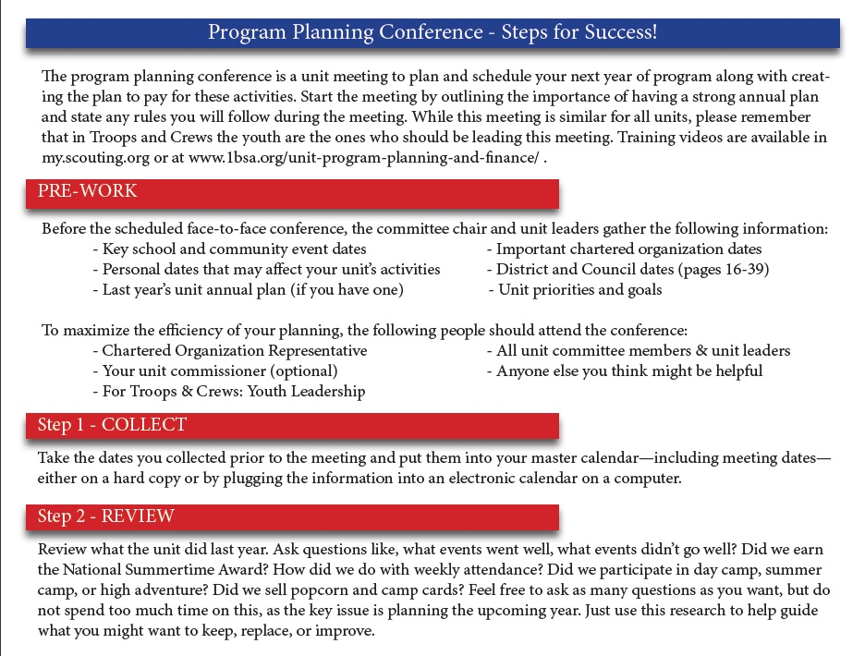
Notes:
The process begins with Pre-work, which is setting the meeting date, inviting the right people, collecting information that will be helpful in the planning process, such as key school dates, personal dates, and your last year’s annual plan (if you have one).
At the meeting:
Step 1 – Is to take the dates you’ve collected prior to the meeting and add them to the Calendar
Step 2 – is to review what the unit did last year. What went well, what didn’t go well. Don’t spend to much time on this step, just use this research to guide what you might want to keep, replace, or improve.

Slide 10
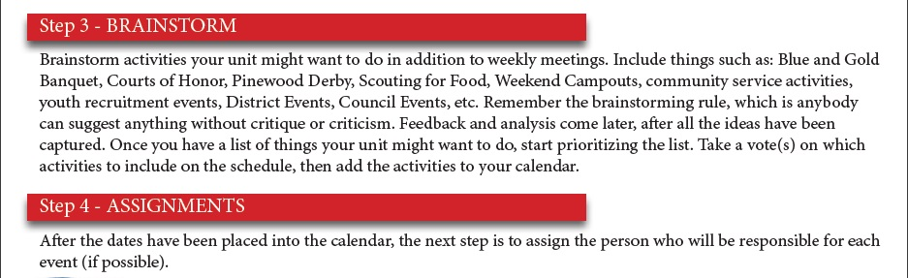
Notes:
Step 3 – Is Brainstorming. What activities do you want to do. Use the Program Planning Calendar for ideas. Create a list of what you might want to do and then prioritize the list. Take votes on which activities to include on the schedule and make your selections.
Step 4 – After you have the activities selected and placed on the schedule, the next step is to assign a person to be in responsible for the activity. Don’t skip this step as it is key to having a successful year.

Slide 11
Step 5 – Finance and Funding
Expense Categories:
Unit Expenses:
Things that the unit typically pays for
Advancement, Unit Gear, Pinewood Derby Cars, etc.
Family Expenses:
Things that the family typically bears the cost of
Cub Haunted, Uniform, Weekend Campouts, Summer Camp, etc.
IMPORTANT! Your funding plan needs to fund BOTH!
Notes:
Step 5 – is Finance and Funding.
We are going to take a second and spend some time on this step.
The costs of Scouting has significantly increased over the past 5 years. From inflation related expenses such as food costs and 3rd party vender costs, to Scouting America membership fee increases (which we expect will increase again).
Many of our units are finding that they lack the funds to continue providing a high-quality program. This needs to be addressed.
CLICK
Scouting Expenses can be broken into 2 categories: Unit Expenses and Family Expenses. READ SLIDE.

Slide 12
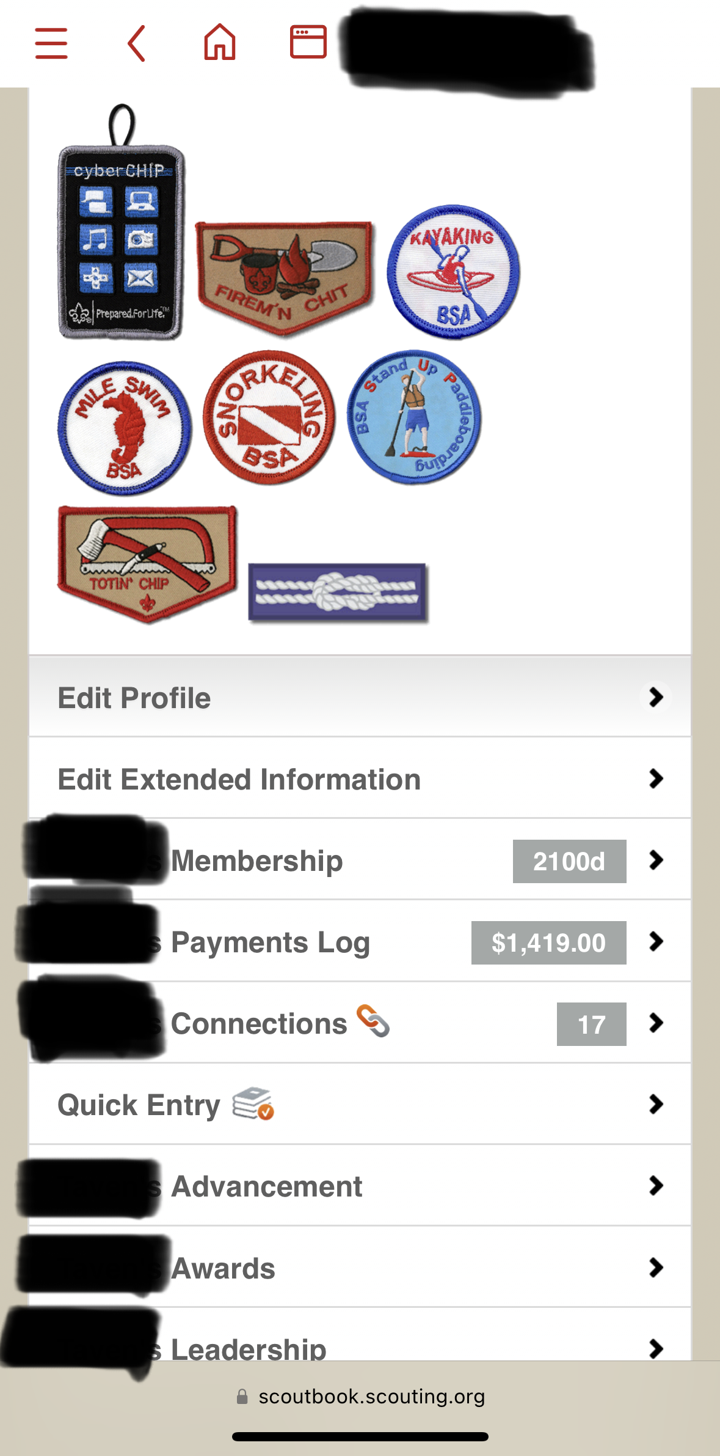

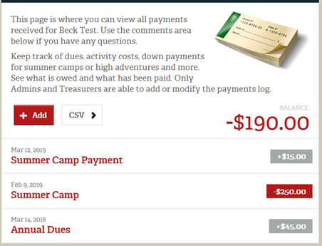
Your funding plan needs to fund the unit expenses
AND
offer a way for families to subsidize their Scouting journey.
Notes:
Your unit’s funding plan needs to fund the unit expenses AND offer a way for families to subsidize their Scouting Journey.
Nearly all our units have a plan to fund the unit expenses, but they often don’t offer a way for families to subsidize their personal expenses.
So let’s talk about Scoutbook Plus and Scoutbook Plus’ Payment Log Function.
CLICK
This function is built right into Scoutbook Plus and allows you to track payments and expenses. It allows each Scout to have a “Scout Account” where Scouts can credit a reasonable amount of funds earned toward their Scouting expenses.
The image on the left is what it looks like when you log in from your phone. You can see the payment log with a balance of $1,419. If you were to click that link it would open up the image on the right that shows credits and debits. The Unit treasurer or other committee member or members can update and use this feature.

Slide 13
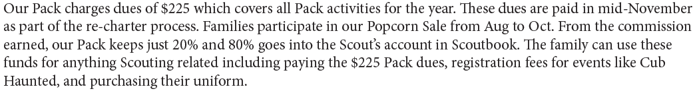
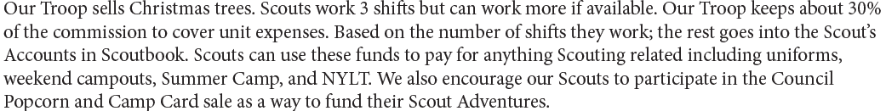
Scout Accounts are important because
INCENTIVES MATTER!
Example 1:
Example 2:
Notes:
Scout Accounts are important because Incentives matter. A strong finance plan incentivizes families to participate and helps ensures that Scouts and families pay their own way. To many of our units are currently being funded by the efforts of only a small percentage of the Scouts and families in the unit which decreases the overall quality of program that the unit is able to provide.
CLICK – Read Example 1
CLICK – Read Example 2
In both examples, the families are incentivized to participate and families that would rather just pay out of pocket are given that option.
There are additional resources available on this subject online, include multiple examples of unit budgets.
We also recommend budgeting some funds to provide camperships to help send your adult leaders to Wood Badge and your older Scouts to NYLT.
If you have any additional questions about Scout accounts, please see the most up to date version of the BSA fiscal policies and procedures for BSA units or talk to your District Executive.

Slide 14

For Scouts BSA, Sea Scout, & Venturing Units:
The process of this meeting is the same but please remember that in Troops, Crews, and Ships the youth are the ones who are holding and leading this meeting.
There are training videos on our website 1bsa.org
Notes:
Step 6 – Now that you have your calendar and finance plan completed, review it to make sure you have captured everything your units wants to do in the upcoming year.
Publish your plan and get it to each family. This can be done via a website, a printable flyer, through Scoutbook, or however your unit likes to communicate.
Program planning is an ongoing process. Review the plan regularly and make sure you are still on track.
For Scouts BSA, Sea Scout, and Venturing Units. READ SLIDE

Slide 15
Council & District Program Support
Notes:
We are going to quickly go through the key events, activities, and trainings for 2026-2027. We have a lot of new and exciting things to share with you!
We are just going to go in the same order of the planning book, so feel free to follow along.

Slide 16



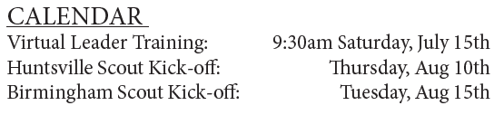
Notes:
Beginning on Page 9 is our Council Popcorn Sale.
Participating in the popcorn sale is important because it helps keep costs down and it is one of the easiest ways to fund your unit expenses and to offer your families a way to subsidize their Scouting Journey.
Our Gathering of Heroes was a HIT! Ask any Scout that attended, they had a blast and won all sorts of great prizes. In 2027, our Gathering of Heroes will return!
This year, we are holding 2 virtual Leader Training sessions! These are going to help get you and your unit prepared for the 2026 Popcorn sale. With new commission structures, an expanded sale period, and more, these trainings will help you be prepared!

Slide 17
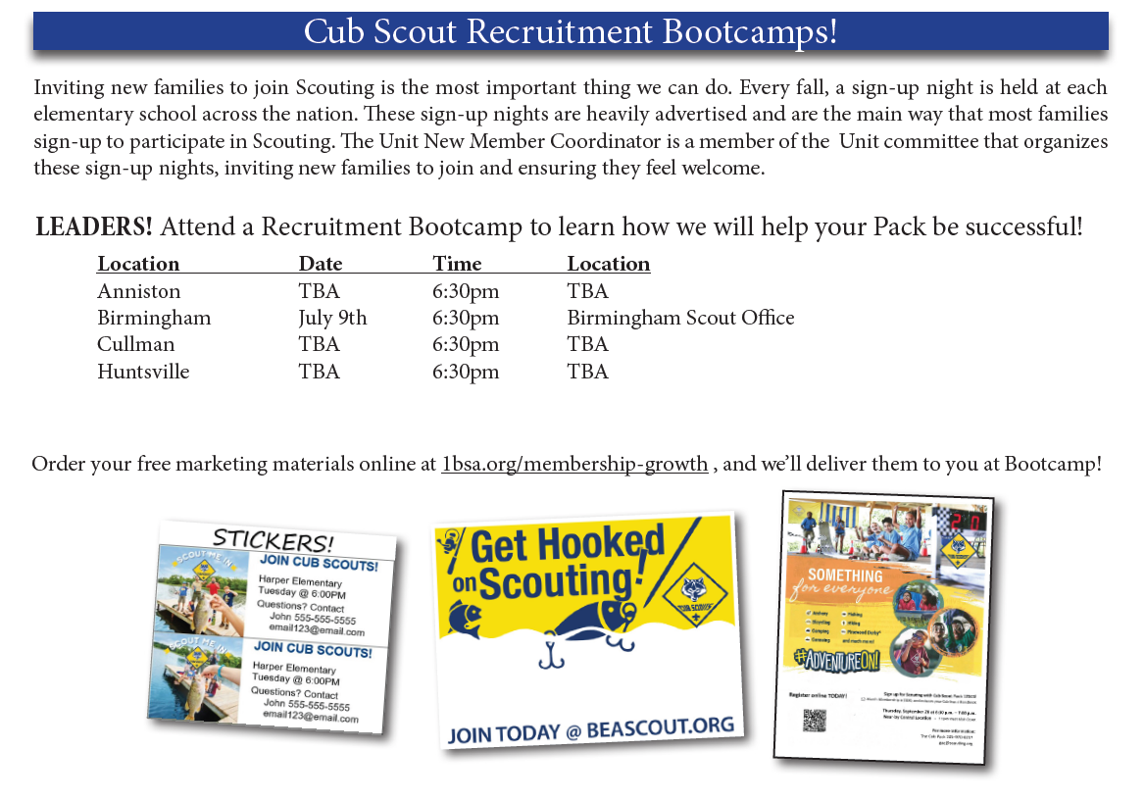
Notes:
We are holding 4 Cub Scout Recruitment Bootcamps! These have been very successful for our Council. As of this date, we are still working on three locations and dates, but we will announce those locations as soon as we have them in place.
Attend and learn how your District Membership Team will work with you to help you have a successful fall recruitment!

Slide 18
Program and Training in 2025 and 2026
Notes:
We are going to quickly go through the key events, activities, and trainings for 2025-2026. We have a lot of exciting opportunities and programs coming up this year.
We are just going to go in the same order of the planning book, so feel free to follow along.

Slide 19


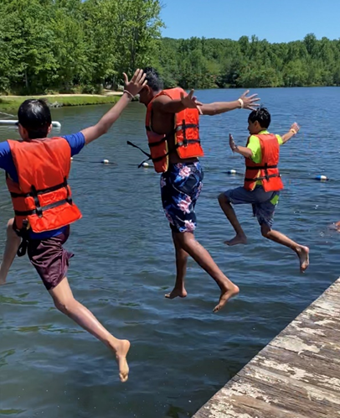
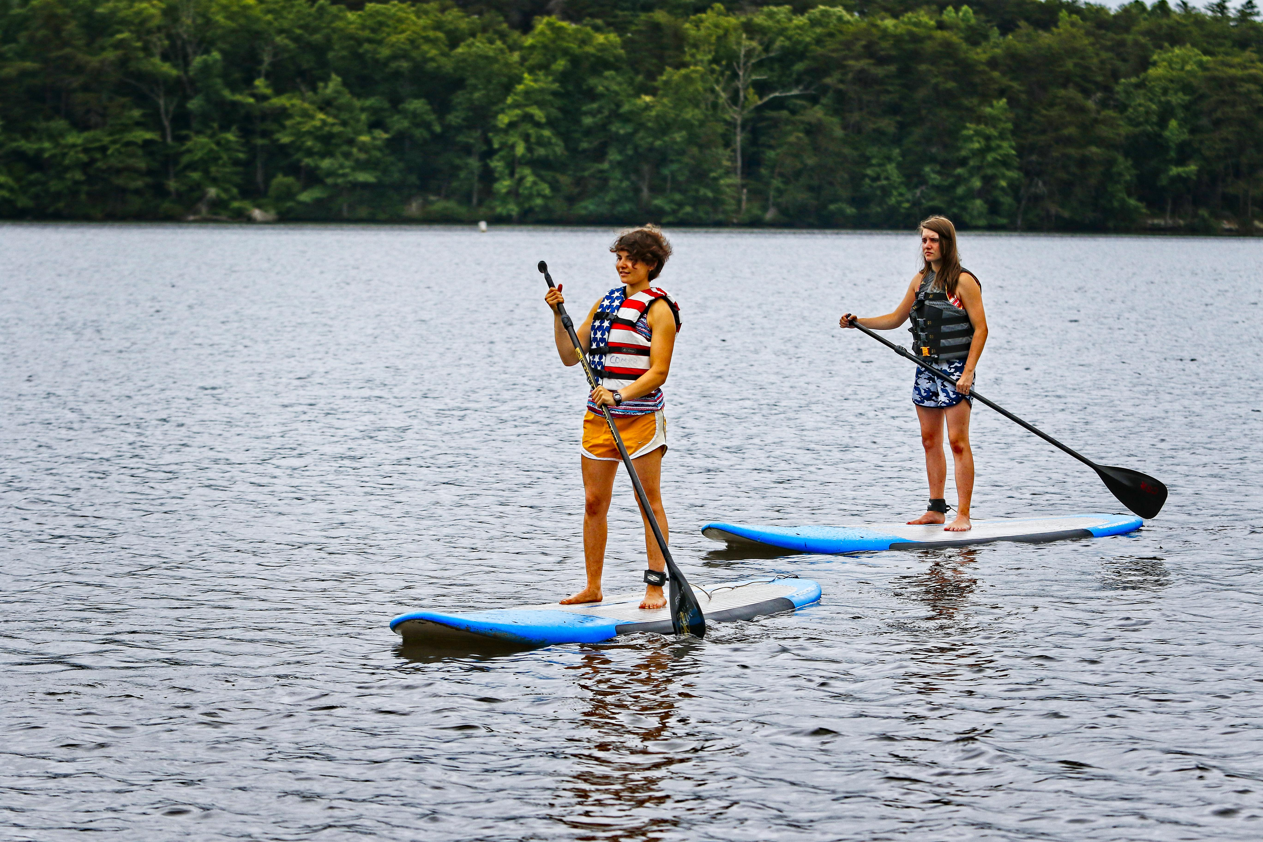


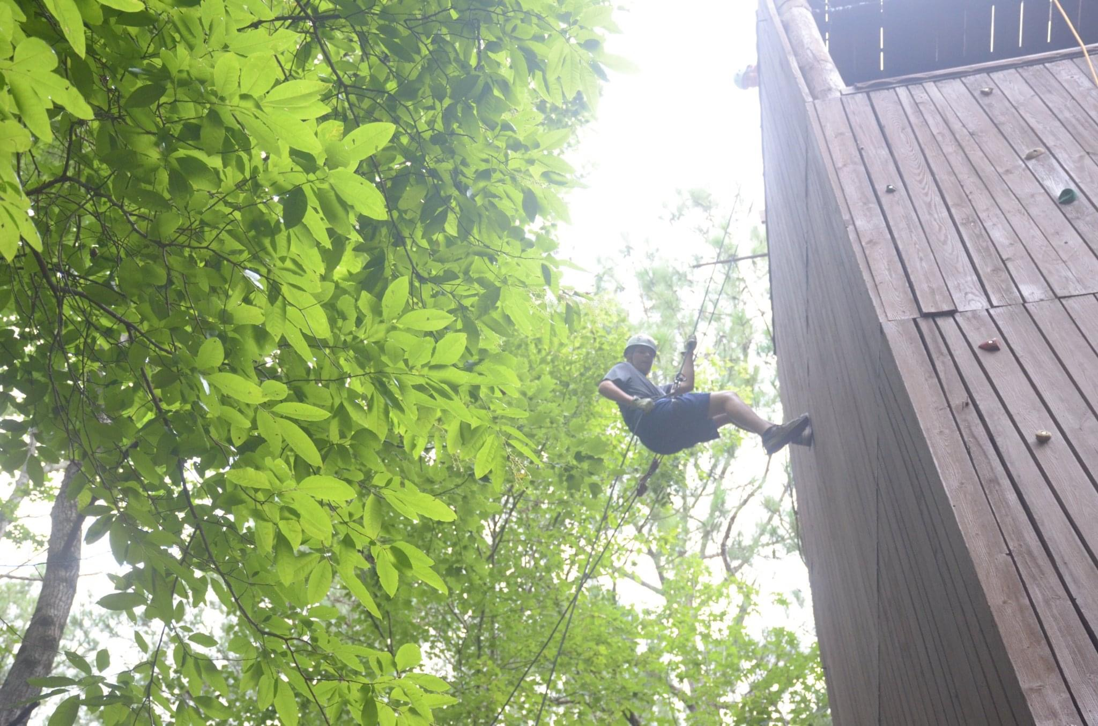
Scouts BSA Summer Camp
Notes:
Scouts BSA Summer Camp at Camp Comer.
Comer is an excellent summer camp that focuses on high quality merit badge instruction. They have great amenities and an awesome waterfront, shooting sports facilities, and repelling program. Comer also features a top-tier first-year camper program called “Trailblazers”. This new program was debuted at Winter Camp 2025 with rave reviews and success!
We also offer Winter Camp at Camp Comer from Dec 27-31. This is like summer camp, but in winter. It’s a great way for Scouts to earn merit badges and get caught up on advancement.
Scouts BSA Summer Camp at Camp Sequoyah.
Camp Sequoyah offers a unique Summer Camp Experience with a high focus on empowering the Senior Patrol Leader and using the patrol method. Each afternoon, troops select 3, 1-hour activities to be completed together. This can include conservation projects, taking out the War Canoe, or making something out of metal at the Metal Forge. They also have a great Eagle Bound Program where Scouts complete hard to earn requirement and the First Aid and Swimming Merit Badges. New in 2025 is the “Sequoyah Mountaineering Corps”- an updated older youth program that will take your Scouts through history for an unforgettable experience!
Come experience “The Sequoyah Difference” at Camp Sequoyah!

Slide 20

Get ready for fun and adventure with Cub Scouts!
Date | Location
September 12 | Joe Wheeler Marina
September 12 | East Lake, Bhm
September 26 | Sylvania Lake
October 3 | Camp Sequoyah
October 17 | Aldridge Gardens
November 7 | Huntsville
November 7 | Indian Springs School, Pelham
Cub Scout Fishing Derbies-
-September - November
-9am-12pm
Cub Haunted Weekends-
-Registration will open early August
-Camp Comer = 6 different sessions
-Westmoreland = 1 Session (Oct. 16-17)
Notes:
We will be holding at least 7 Fishing derby’s this fall. These are designed for new Cub Scouts that join, but all Cub Scouts are invited to attend the derby closest to them.
Cub Haunted Weekend Registration will open in early August. Cub Haunted is an exciting weekend of fun for Cub Scouts and their families at camp. Cubs get to participate in range and target sports, field games, hay rides, crafts, and so much more! Please make sure to register early as participation is limited and we do Sell Out.

Slide 21
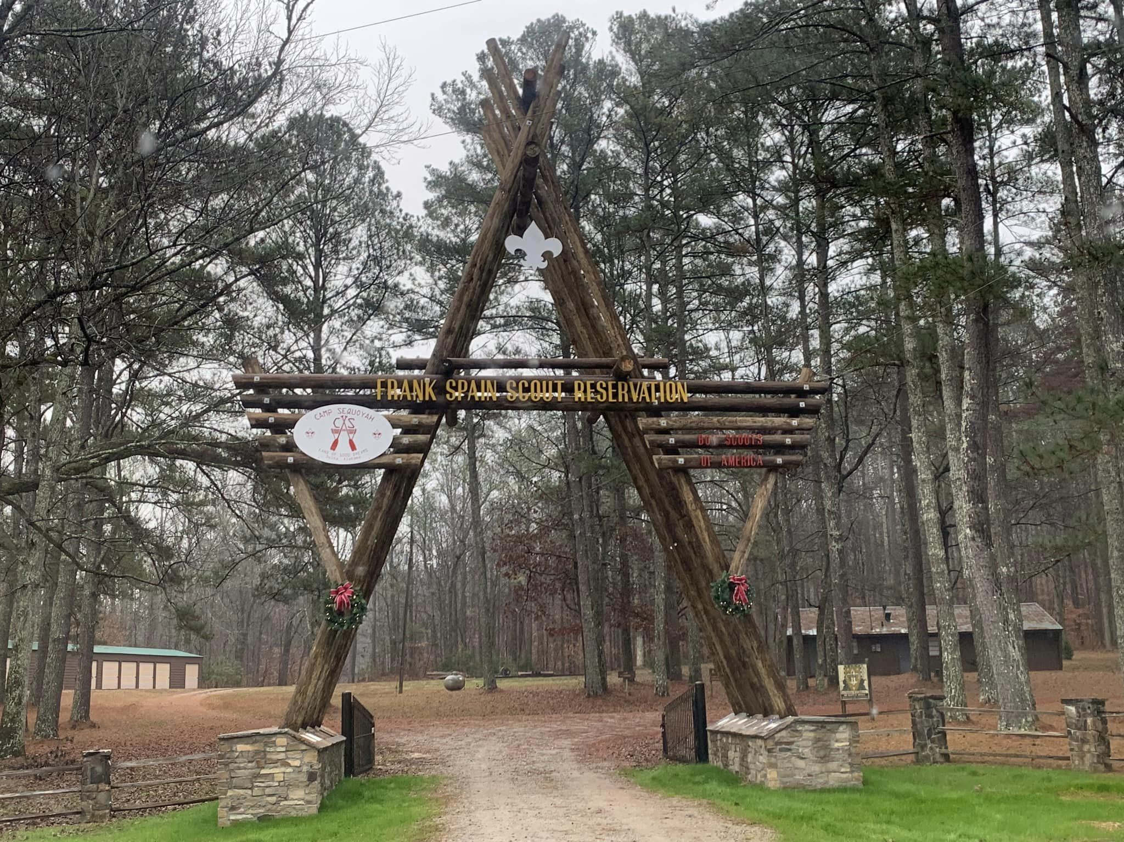
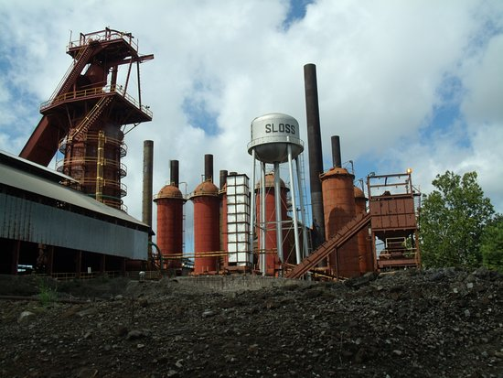
Get ready for fun and adventure with Cub Scouts!
Joy to the Woods Holiday Campout
December 11-13
Cub Scout Cast Iron Quest
June 6th
Sloss Furnaces National Historic Landmark
Notes:
Back for 2026 is the Joy to the Woods Holiday Campout! This weekend long campout at Camp Sequoyah brings the holiday cheer to Cub Scouts and their families! Cubs get to enjoy fishing, range and target sports, holiday themed crafts, hot chocolate, holiday cookies, and more during this weekend of fun at camp!
Back for the final time in 2026 is the Cast Iron Quest! This fun filled day at Sloss Furnaces in Birmingham is a blast! Cubs get to learn about the iron industry in Alabama, they get to participate in a wide variety of exciting program stations, they get to make their own piece of art with skilled metal artisans, and watch an IRON POUR! Registration is now open for this exciting event!

Slide 22


Get ready for fun and adventure with Cub Scouts!
Webelos and Arrow of Light Resident Camp
July 12-15
Camp Comer
REGISTRATION OPEN!
Cub Scout Summer Camp
July 15-18
Camp Comer
REGISTRATION OPEN!
Notes:
Splash into summer fun! Cub Scout Summer Camp is a 4-Day 3-Night adventure for Tigers, Wolves, and Bears at Camp Comer. It is all about Aquatics and the waterfront. How many Cub Scouts have seen that waterslide but never had the opportunity to slide down it? Now they will!
Webelos Camp is our highly attended and amazing program for Webelos and Arrow of Light Scouts. It is also 4-Day, 3-Night adventure that is a blast!

Slide 23






Notes:
Woodbadge is the amazing training program for adult leaders. It is designed to be taken within the first 2 years of becoming an adult leader. Having leaders attend will dramatically improve your unit's overall program and the quality of experience being provided to your Scouts. The dates for the Fall 2026 Course are: Sept. 25-27 and October 17-18. The Spring 2027 Course dates are: March 12-14 and April 3-4
National Youth Leadership Training. NYLT. This is advanced leadership training for youth. We offer two courses, one in January/Feb, and the other will be June 23-28 at Camp Westmoreland. There are still slots available for the June NYLT course, so encourage your Scouts, Venturers, and Sea Scouts to register today!
University of Scouting will be February 27, 2027 at Wallace State Community College in Hanceville. University of Scouting is a day of supplemental training with over 100 classes. These are fun classes from Dutch oven cooking, to practical skills. We have classes on how to improve your unit’s finances, or how to make your unit meetings more engaging. It’s an easy day of fun and fellowship and it’s a great way to get your parents and unit leaders more engaged.
- As part of the this we include a Merit Badge College for Scouts BSA youth. Scouts are able to take 2 merit badges that day.
Seabadge will be making its second-ever port call in Alabama in 2027! The tentative course dates are September 10-12, 2027 Camp Comer. This adult leader training program is open to all registered adult leaders (Scouts BSA, Venturing, and especially Sea Scouting) and it helps you gain the tools and skills for working with older youth and helping them stay engaged and involved.
Fish Camp @ Camp Sequoyah is for Scouts BSA, Sea Scouts, and Venturers. Scouts will work on the Fishing merit badges and work on earning the BSA’s angler award. The BSA’s Angling Educator Training will be available for Adults looking to add additional skills and tools to help deliver the Scouting program. In March of 2027, the Council will be hosting a Certified Angling Instructor Training at Camp Sequoyah. This weekend-long training course equips you with the tools and resources necessary to help Scouts of all ages get out and enjoy fishing and angling wherever they may be. It will also uniquely qualify you as a merit badge counselor for the Fishing, Fly Fishing, and Fish and Wildlife Management merit badges!
This November 6-8, there will be a Leave No Trace Skills course held at Camp Jackson. This weekend-long course is a must-do for unit leaders (especially those involved in planning or leading their unit’s outdoor programs), Staff for any Scouting training course such as BALOO or IOLS, Unit Commissioners, District Committee Members (Like Program Chairs, Camporee Chairs, and Camping Chairs), Council-level volunteers, Scouting Professionals (Camp Rangers, Commissioned Professionals, and District Executive Staff), and Summer Camp Staff Members. You can learn more at 1bsa.org/adult-leader-trainings/

Slide 24
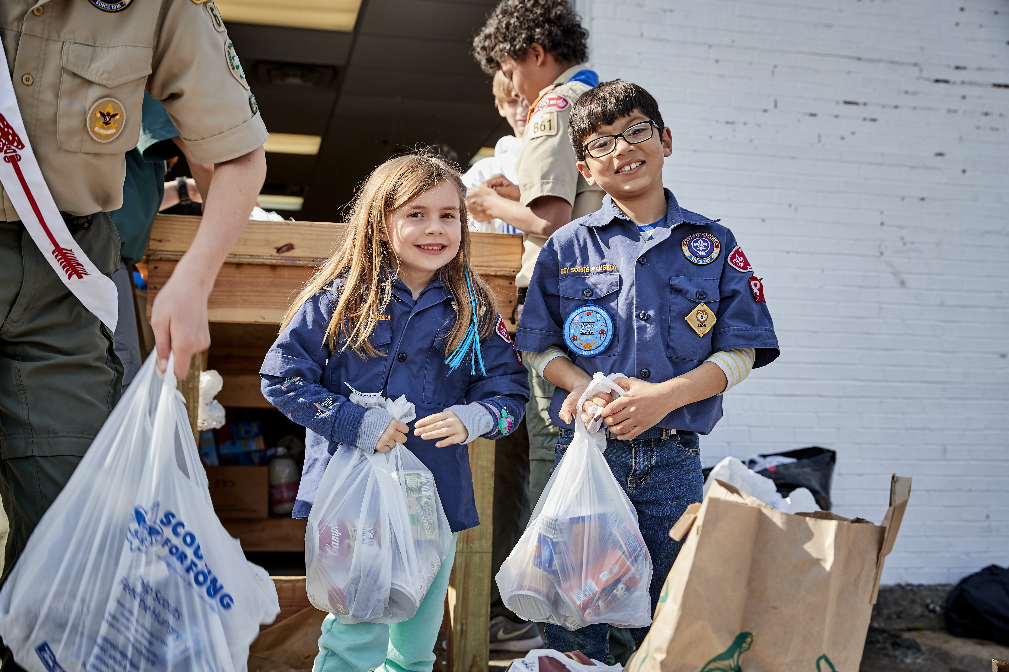
Scouting for Food
Late October is Door Hanger Distribution
November is Food Pick-up and Drop Off
Drop-off dates will be announced later in 2026
Notes:
A Scout is Helpful. Scouting For Food is a one-of-a-kind service opportunity where Scouts help gather food to help those who suffer from food insecurity. The participation schedule is flexible. Please include this In your annual plan.
Currently, we are working with our ScoutFest Team and our Community Food Bank partners to coordinate drop-off at ScoutFest this fall. We will have more information on that closer to time.
Speaking of ScoutFest…

Slide 25

ScoutFest 2026
Notes:
Join us November 13-15 at American Village in Montevallo for a celebration 250 years in the making! ScoutFest will have activities, events, and festivities for everyone- Cub Scouts, Scouts BSA, Sea Scouts, and Venturers! This weekend will feature exhibitor midway, interactive events and attractions, Wood Badge and NYLT Reunions, displays, skill events, and so much more! Be sure to check out scoutfest.com or 1bsa.org/scoutfest/ regularly for updates on activities, registration, and other news and highlights!

Slide 26
Key District Events
Notes:
Update for Area/District

Slide 27
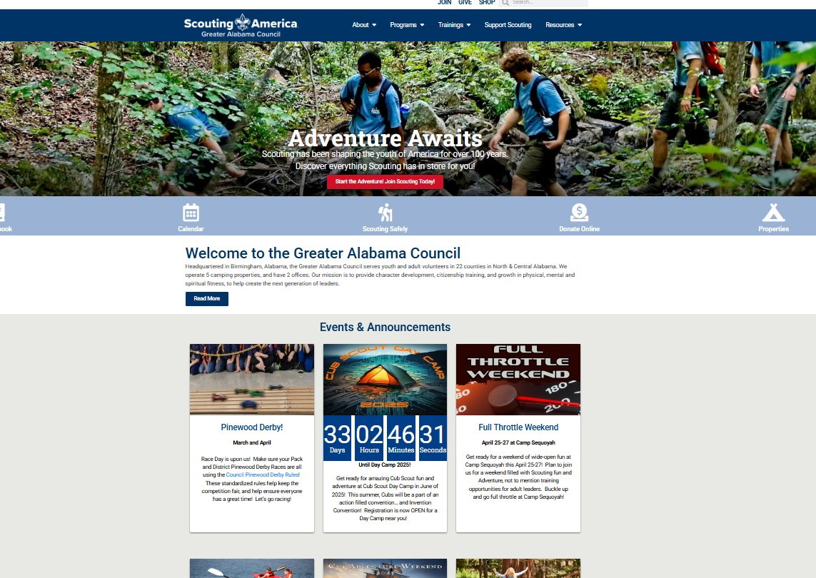
Visit 1bsa.org
Notes:
The Council website is the best place for up-to-date information. Check it often.

Slide 28
Program Planning Kick-off & Training

