Slide 1
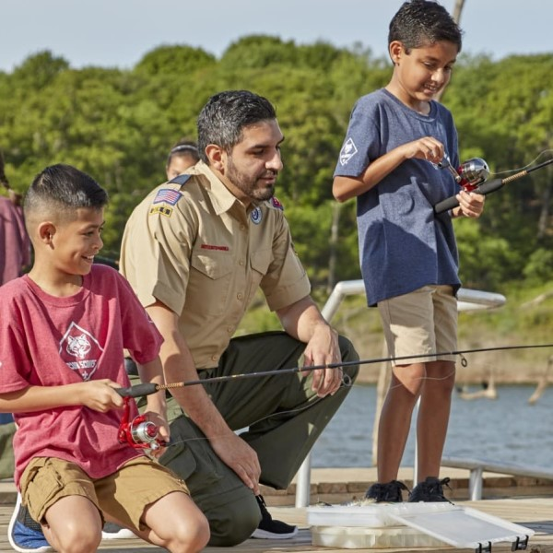
Notes:
You can change the picture if you’d like.

Slide 2
Welcome to Pack 123!
Intros
(insert picture of pack doing something fun!)
Notes:
UPDATE FOR YOUR PACK: Unit Number, Intro’s etc. (see items in yellow)
Introduce self and welcome everyone to the meeting

Slide 3
What is Cub Scouts?
Cub Scouting is fun!
Families spend time together!
Program for all youth in grades K-5
Do things and go places!
Earn awards!
Do activities and go to camp!
Year round program!
Notes:
Explain what Cub Scouts is all about. Make sure to be enthusiastic!

Slide 4
Things we do:
Fishing
Skating Party
4th of July parade
Rocket launch
Bike rodeo
Pinewood derby
Day Camp!
Notes:
UPDATE FOR YOUR PACK: Insert activities & picture specific to your Pack.
Tell the families what they will do with your pack, be specific.
Share Printed Copies of your Pack Calendar

Slide 5
Scouting’s Youth Magazine
Official magazine of the BSA
Order through the Pack and you will receive the Cub Scout edition
Boys‘ Life is $1 per month and delivered to your child
Notes:
Explain Boy’s life magazine

Slide 6
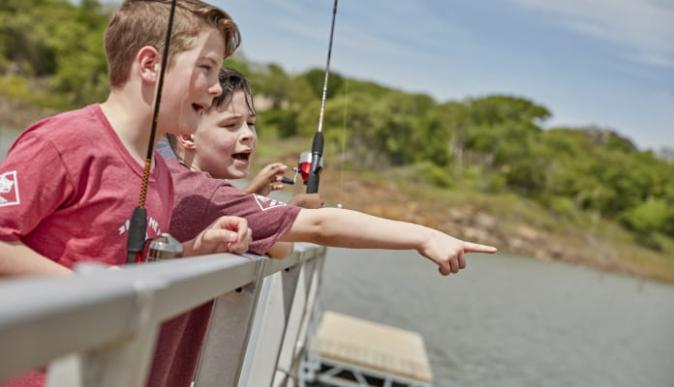
Fishing Derby!
Fishing, Fun, Prizes, and your 1st Patch!
September XXth at (Enter Location)
9:00am – 12:00pm / Cost: $10
Notes:
UPDATE with your local Fishing Derby information

Slide 7
Cub Activity Time!
Notes:
All new and current Cub Scouts are taken to another location to work on the Bobcat Badge or do an activity.
You’ll need at least 2 adults to run this.
Tell the parents what will happen with their kids, Introduce the Adult Leaders and explain what the youth will be working on.
This will give parents the opportunity to focus their attention on the details.

Slide 8
Pack 123 - Organization
The Pack is all of the youth (grades K-5) and their adult leaders
The Pack meets once a month for a fun meeting (Pack meeting)
Notes:
Explain how the pack is organized, when they meet and how the Dens work.

Slide 9
Dens
The Pack is divided into “Dens” by grade & gender, Dens meet 2-3 times a month.
Lions (Kindergarten)
Tiger (1st grade)
Wolf (2nd grade)
Bear (3rd grade)
Webelos (4th grade)
Arrow of Lights (5th grade)
All Scout Activities are age-appropriate
All Dens are singe-gender

Slide 10
Volunteers
Parents make Scouting go!
Cub Scouts is designed to help parents spend time with their child
Parents participate with their child
Parents are the major source of pack leadership (plan events, run den meetings)
Notes:
Explain how Cub Scouts is designed to give parents and opportunity to spend time with their kids.
Parents make up the volunteers who make the pack go.

Slide 11
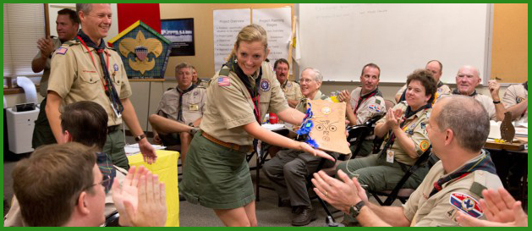
Training for Volunteers
Online & In-Person Training is offered to ensure a quality program and to keep our youth safe
Every Scout deserves a trained leader
Notes:
Tell them how training is provided to help all volunteers be successful!

Slide 12
We are Pack 123!
We are chartered by:
We are part of the District
of the Greater Alabama Council
Notes:
Update Chartered Organization and District
Explain who the pack is chartered by, the district you belong to and a little about our Council.

Slide 13
Pack Meeting
Our Pack meetings are held on:
Our next Pack meeting is:
Location:
Time:
Notes:
VERY IMPORTANT! – Update with your pack’s information.
Explain when your next Pack meeting is and make sure everyone leaves with the information.

Slide 14
Pack Leadership
Cub Master contact info:
Committee Chair contact info:
Notes:
IMPORTANT: Update with your pack information.

Slide 15
How the Pack funds itself
Pack dues (if any)
Annual fundraisers
Popcorn Sales
Camp Card Sales
Notes:
UPDATE: Tell the parents how much Scouting in your Pack will costs and what fundraisers you do to offset the costs.
Pack’s with a strong program and funding plan attract and keep families

Slide 16
Registration Fees
$25 Joining Fee, plus $6 a month
Pay’s for registration through Dec.
Annual Registration (Jan to Dec) is $72 a year
Boys’ Life Magazine is $5
Pack Dues are $ (if any, or delete)
Make checks payable to “_________”
There will be additional costs for campouts, uniforms etc.
Notes:
UPDATE: Review the registration fee’s, Boy’s Life Magazine Fee, Pack Due’s if any.

Slide 17
Friends of Scouting
The $6 a month paid to participate in Cub Scouts is not the full cost of Scouting.
Each family will be asked to make a charitable contribution to support Scouting at some point during the year.
We refer to these donations as
Friends of Scouting.
Notes:
Read this slide verbatim. (don’t expound)
It is important that families understand that the full cost to join Scouting is significantly higher than $6 a month.
To allow all youth the opportunity to be a scout, we give parents and philanthropic individuals the opportunity to support Scouting thus keeping youth joining costs low.
Simply read the slide.

Slide 18
Den Breakouts
Take 10 Minutes to
Ensure all Dens have full leadership!
Notes:
Utilize the Magic Circle Technique to recruit and fill vacancies, such as den leaders, committee members etc.
Magic Circle instructions found at www.1bsa.org/membership

Slide 19
Scout Presentation!
Notes:
Have youth show their parents what they’ve learned - recite Cub Scouts Promise and Sign

Slide 20
Questions?

