Slide 1
Arrowhead District Roundtable
Greater Alabama Council
6 JAN 22

Slide 2
Recharter Status
Latest on-line info we have: Note, may be out of date
Posted – Complete
Troop 236
Submitted awaiting Process
Crew 310
Pack 91, 140, 236, 275 & 282
Troop 92, 221, 282, 336 & 455
In Progress
Pack 221
Troop 21, 91, & 142 (91 & 142 – Awaiting COR Sign)
Not Started
Pack 24
Reminder JTE should be turned in with re-charter

Slide 3
Recharter and United Methodists
The UMC and BSA have reached an agreement on past and future liability coverage and the UMC is promising to support and help grow Scouting in the future.
No word on how charters will work going forward, there are still more negotiations to go.
The BSA has agreed to waive the $75 Unit Liability fee (charter fee) but will require all active youth and adult participants to pay their annual registration fees and follow the normal rechartering process.

Slide 4
Program Planning Year
Plan
We’re midway through the Scout planning year. What needs to change? Is the PLC engaged? What about Summer Camp?
Long range plans for Pinewood Derby, B&G, Crossover, and leadership transition.
Fund
Time to start thinking about Popcorn (what already?)
Has fundraising met the budget plan? Why not?
Grow
Planning for Webelos to Scout transition should be happening. Where are your webs going?
What is your units plan for retaining Scouts? What does focusing on retention mean?

Slide 5
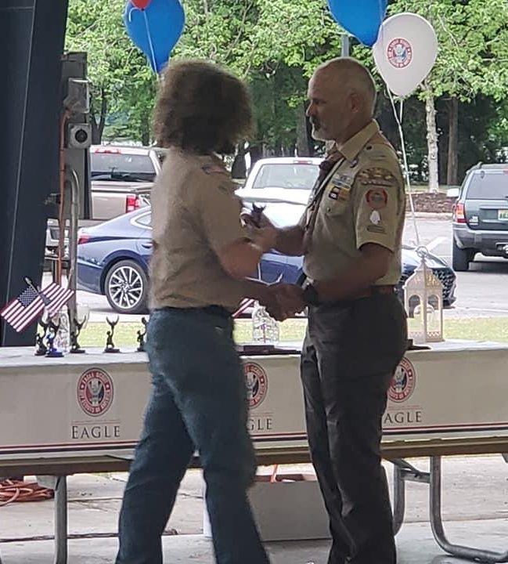
District Banquet
March 3, 2022, 5pm to 9pm
Point Mallard Large Pavilion
We chose to meet outside again this year due to COVID. This will be a bring-you-own picnic supper instead of a catered meal.
Looking for volunteers to help with planning and decorating.
Currently accepting nominations for the District Award of Merit
Unit leaders - let’s recognize our volunteers. Get in those training awards!

Slide 6
Spring Camporee
Spring Camporee is tentatively scheduled for 8-10 APR 22.
Camporee is being hosted by Troop 142.
More details to come.
Scout Units: Please work with the OA to schedule elections.

Slide 7
Cub Adventure Weekend
April 1-3, 2022
Camp Comer
Cubs and the families will participate in a wide range of events that will test their skills and be a lot of fun. Cubs will receive a patch. T-shirts will be available for purchase.
https://1bsa.org/cub-adventure-weekend/

Slide 8
NYLT
Winter NLYT may be full, only had 2 slots before Christmas.
2022 Winter Course January 15-17 @ Camp Comer February 19-21 @ Camp Comer Scoutmaster: Kristy Phelps nyltwinter2022@gmail.com
2022 Summer Course June 26-July 2 @ Camp Westmoreland Scoutmaster: David Luthin
NYLT22.2SM@gmail.com
https://1bsa.org/nylt/

Slide 9
Wood Badge
2022 Wood Badge Course 14-122 April 8-10, Camp Comer
April 30- May 1 2022, Camp Jackson
Cost: $250
Scoutmaster Ron Moore
Email: SMWB14122@gmail.com
https://1bsa.org/woodbadge

Slide 10
Upcoming Opportunities
University of Scouting: 5 MAR 22: https://1bsa.org/university-of-scouting/
Wilderness First Aid: 4-5 MAR 22: https://caincreek.com/events/wfamar22
IOLS/BALOO: 22 APR – 24 APR 22: Details coming.
National Scout Jamboree: 21-30 JUL: https://1bsa.org/national-scout-jamboree
District Pinewood Derby. Need a sponsor. Pack 282 has done it for several years.

Slide 11
Invitation Manager
All Units with leads have been contacted

Slide 12
Application Manager
All Units with pending applications have been contacted

Slide 13
District Membership Totals

Slide 14
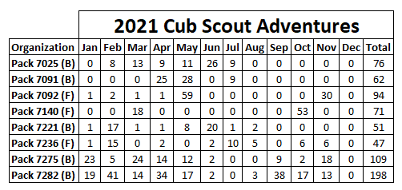
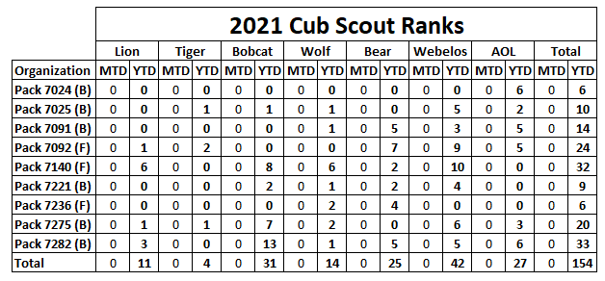
Advancement

Slide 15
Advancement

Slide 16
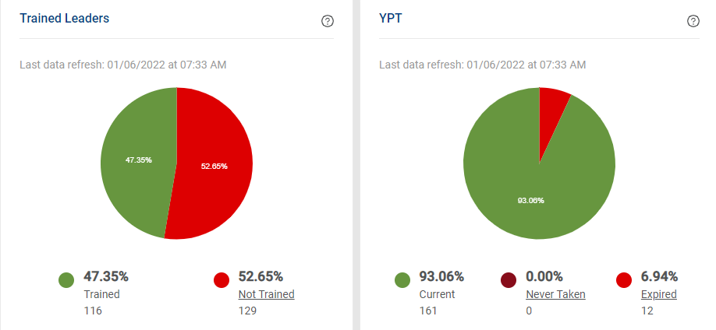
Training

Slide 17
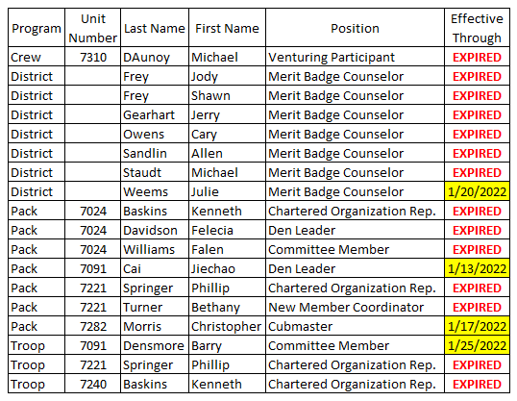
Expired YPT

Slide 18
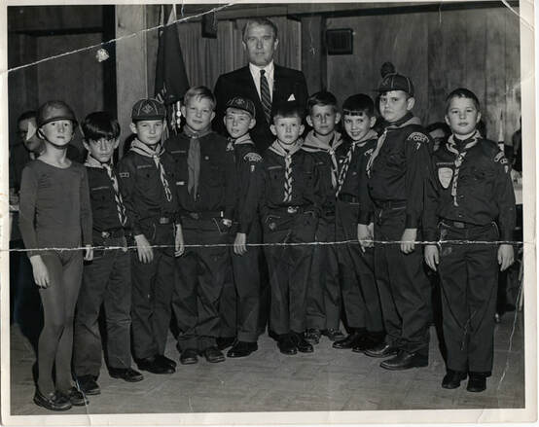
Remember Why We Do This
Scouting is all about our Scouts!

