Slide 1
Internet Re-Charter
Notes:
Welcome everyone to the re-charter training. Start on time and end on time. This training should last approximately and hour and 15 minutes.
Introduce self, commissioners and other district leaders in the room.
Ask people to hold their questions until the end of the training.

Slide 2
What is Re-Charter?
Renewal of the Chartered Organizations annual commitment to continue owning and operating a Scouting unit
Annual renewal of individual BSA memberships
Authorization for the organization to use the BSA’s Intellectual Property
Renewal is from January 1st to December 31st
Notes:
Explain what recharter is. Read the slide.

Slide 3
What is the Re-charter Process?
Step 1: Attend Recharter Kick-off, get your Recharter Access Code
Step 2: Register online and complete online steps 1-2.
Step 3: Inventory your members and collect fees.
Step 4: Complete online steps 3-5: Update roster and Submit
Step 5: Obtain signatures and collect missing Items
Step 6: Turn in paperwork at the District Wild Beast Feast!
Notes:
Quickly Review the Process. DO NOT give too much details at this point, the goal is to give them a quick overview of the process.
We will review each of the 6 steps in this training.

Slide 4
This Training will walk you through the Re-charter process
and will provide you with 8 helpful tips.
TIP #1:
Our Council office cannot process
Incomplete Re-charters.
All Re-charters must be PERFECT, in order to be processed.
This training will help you complete a perfect charter
Notes:
This training will provide them with a general overview and with some helpful Tips. Tip 1 is very important. Incomplete recharter must be cleaned up before they can be processed.
Incomplete recharters are very time consuming to fix. It is very helpful to have the charters arrive ready to go.

Slide 5
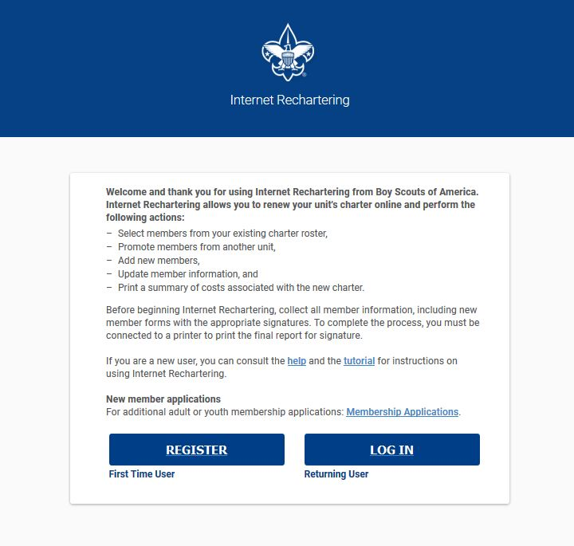
STEP 2: Register and complete steps 1-2
Visit the Council website or my.scouting.org to get to the online system.
Access Code is on your Packet!
Click Register
Notes:
Unit’s can access the online recharter system through my.scouting.org – menu – legacy tools – Internet Rechartering.
They can also access the login page from the Council Website on homepage sor in the resources tab – recharter.
Their access code is provided on their recharter packet. They will need to get register the first time they visit the website every year.
The Leader Click’s Register to begin the process.
Once Registered a person can exit the system and log back into the system from any computer or device.

Slide 6
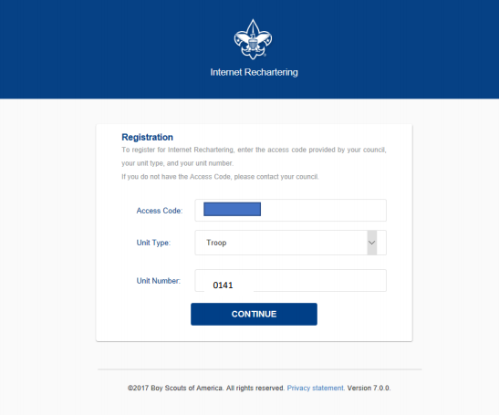
Enter Your Access Code:
Select Unit Type
Enter Unit Number
(All 4 Digits, including zeroes)
Notes:
As part of the registration, the leader will enter their access code and unit number. All 4 digits must be there including zero.
This is one of the first things that holds people up, forgetting the zero.

Slide 7
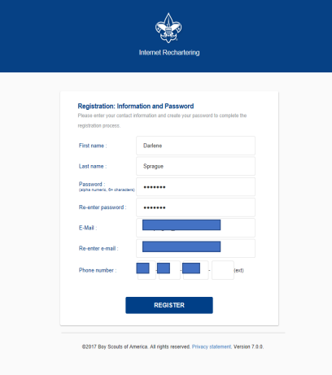
Create a Password
&
WRITE IT DOWN!!!!
Notes:
Create an account and password and WRITE IT DOWN!!!
Many people don’t do this and the only way to get back into the system is to reset the re-charter which causes the person to loose anything that they had already done.

Slide 8
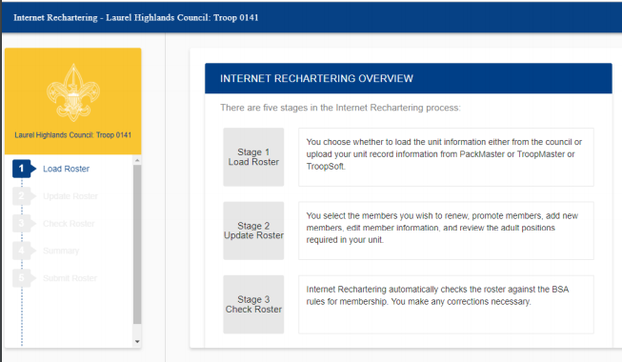
The Stages of Internet Recharter Appear on this screen.
You will progress through these stages until all information and all BSA requirements have been met.
Notes:
On the left side of the screen shows the stages of the online system. There are 5 stages and each stage has different sections. These sections will be shown as drop downs.
A person can quickly get to any stage of the re-charter process by clicking on the left side.

Slide 9
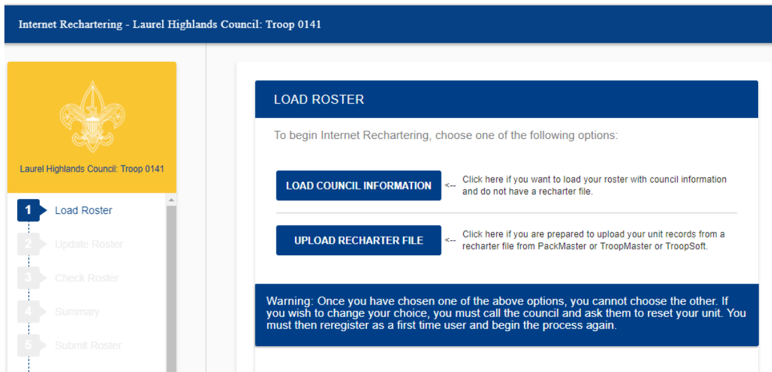
Load Current Roster
Select “Load Council Information”
TIP #2 – Don’t use “Upload Recharter File”, it causes problems!
Notes:
Stage 1 is to load the unit roster. This should be done by collecting the information from my.scouting.org by selecting “Load Council Information”.
Units have an option to upload form a 3rd party software, but this is not recommended as it can cause a lot of additional paperwork for the unit at the later stages of the re-charter.

Slide 10
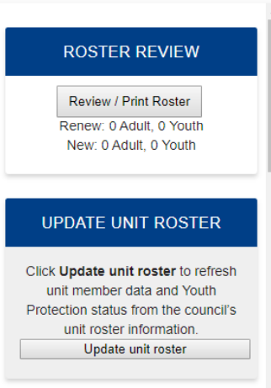
You now have a “Working Copy” of your re-charter
Changes don’t take effect until you click “Submit”
Changes made by the Office
will not appear unless you click
the “Update Unit Roster” button.
Example: Youth
Applications
that were
processed by
the office
Notes:
Once the roster is loaded you have a working copy of the re-charter. You can make changes, save things, leave, come back, etc. nothing will take effect until you click “submit”
If an application comes across the front desk of the office, it will show up in the recharter but only after you click “Update Unit Roster”
It’s a good idea to click this each time you log in.
Once you submit the re-charter to council, any application that we have in hand will be added to the re-charter after the recharter is posted. You may receive a call stating that not enough money was collected for the youth or adult if that person didn’t submit enough money to get them through the re-charter process.

Slide 11
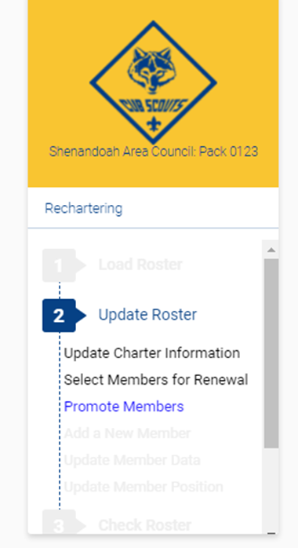
Follow the steps to:
Update Charter Information
Select Members for Renewal
Add new youth and adult members
Update Member Data
Update Member Position
Notes:
Continue to follow the online steps listed above.

Slide 12

Tip #3: DO NOT USE the “Promote Members” option
Just Skip this part.
Youth joining a new unit must fill out a new application even if you use this option, this only causes problems
Notes:
You won’t be able to use this unless you have administrative rights to the other unit. Just ignore it, it’s a hassle and doesn’t save any time. Evan if it is used correctly, the youth will need to submit a new application with the new unit anyway so this feature is really pretty useless.

Slide 13

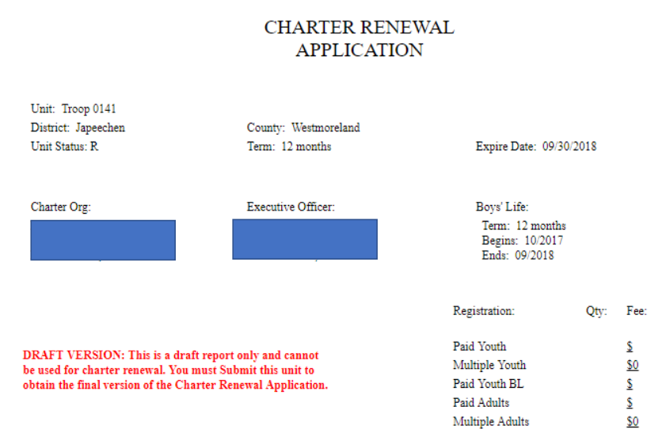
Tip #4: To help you collect fees and inventory your members, you can print your roster by pressing the Review/Print Roster Button.
Note:
This is a DRAFT!
Don’t turn this in as it can’t be accepted.
Notes:
You can print a draft version of your roster which will allow you to take notes and track what you’ve collected.

Slide 14
Step 3: Inventory your members & Collect Fees
Verify who is re-chartering, both youth and adults
Collect Fees:
- BSA Membership Fee: $___ per person
- Chartered Org Liability Fee: $___
- Boy’s Life Magazine: $___ per person
The Membership Fee’s will increase.
New amounts will be announced In October and updated in the re-charter system on Nov 1st.
Notes:
This is the hard part. You must find out who is re-chartering and collect their fees. This can be done at a unit meeting or via phone calls etc.
The Chartered Organization should be paying the $40 liability insurance fee.
As of 9.17.19 Fees are : $33 a person / $40 liability insurance / $12 Boy’s Life Magazine. These fees will change.

Slide 15
Youth Protection Training
Before the online system will allow you to “submit” every adult leader must have a current Youth Protection Training Certificate.
Certification lasts 2 years.
Tip #5: You will need to click the “Update unit roster” Button to update training records on your re-charter.
Notes:
We highly prefer that all adults create a my.scouting.org account and complete youth protection online. There are computers available at the office for those who need help. This can also be done via a smart phone or device.
By doing it online, the person creates an account, enters an e-mail address and gets reminder e-mails stating that they have completed the training or that they need to re-take the training in the future. It also gives them access to the many tools available to them via my.scouting.org.
Each district is holding a youth protection training at their Roundtables in November for those who need it, but we prefer this be taken online.

Slide 16
Tip #6: Improve your Trained Leader % for Journey to Excellence by registering Adults in the Proper location.
Adults who are not active with the unit can be registered as a Unit Scouter Reserve or as a College Scouter Reserve.
Use these positions instead of Assistant Scoutmaster or Committee Member to help increase your trained leader %.
Notes:
Read Slide.
The Key is to register leaders where they should be registered. Alumni Scouters or Scouters who aren’t active in the unit should be registered as Unit Scouter Reserve.
College Scouter reserve is for Young Adults 18+ who grew up in the unit but are off at collage and don’t want their membership to lapse.

Slide 17
Step 4 – Complete online steps 3-5
Update your roster using the info you’ve collected
Click “Check Roster”
System will check your roster for errors & warnings
Error must be fixed
Ie: Adult has no Youth Protection
Ie: Not enough adults
Warnings should be fixed (if true fix, ignore false alarms)
Ie: Youth appears to old to be a Webelos
Once fixed click “Re-Validate”
Notes:
After you have collected all of the information, that information needs to be entered into the re-charter system. This can be time consuming so it is recommended to get all youth and adult app’s to the office ASAP and let the office do the data entry. They are currently operating at same day or next day entry as long as the app’s are not incomplete when they are turned in.
After your roster has been updated, you will click “Check Roster” This will check the roster for any errors. If it finds any errors, those errors must be fixed before you can continue. The most common errors are: Adults without youth protection; not having enough adults and not have adults in the correct positions.
Warnings are not very common but do happen. These are things that may or may not be errors. They should be fixed if they are true errors but you can ignore false alarms. The most common warning is related to youth ages and what Den they are in for example a youth is 11 and still an arrow of light scout.
Once all of the errors and warnings are fixed, click “Re-validate” and it will let you go to the next section.

Slide 18
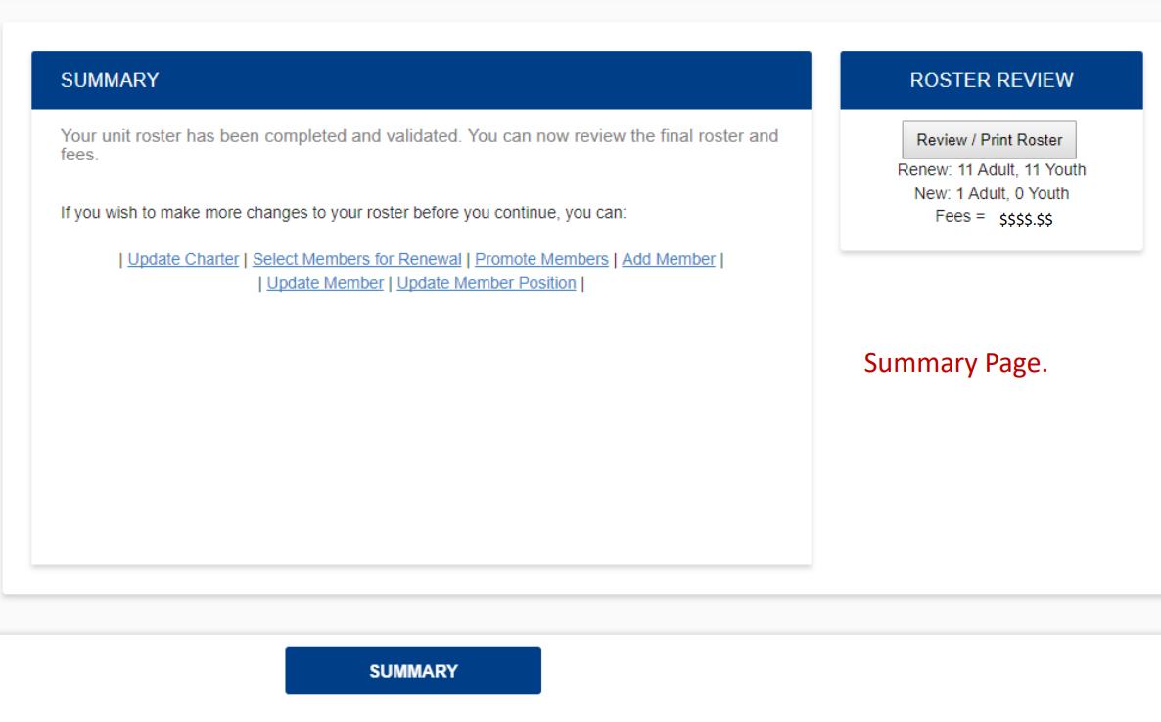
Click Summary
Notes:
The next section is the summary page. Click Summary.

Slide 19
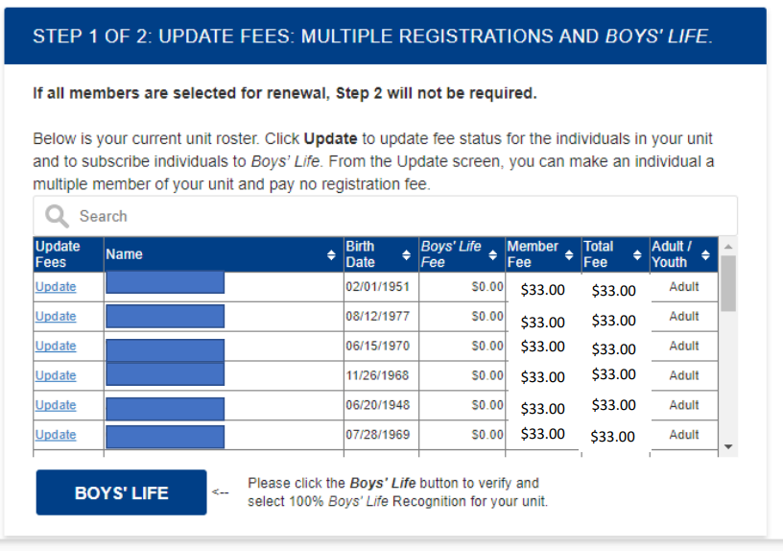
Update Your Fees:
Notes:
This provides you with a summary of the recharter. At this point you can update the fees, add boys life, and note multiple registrations.
On Multiple Registrations: A person only pays their annual membership dues in one location. This can cause problems if both units say the person is going to pay in the other unit and then the person never actually gets paid for. When this happens it causes both recharters to be “incomplete” an neither can be processed.
If you have any adults or youth that are multiple registration make sure you have communicated with them and know for sure what unit they are going to pay their dues in!

Slide 20
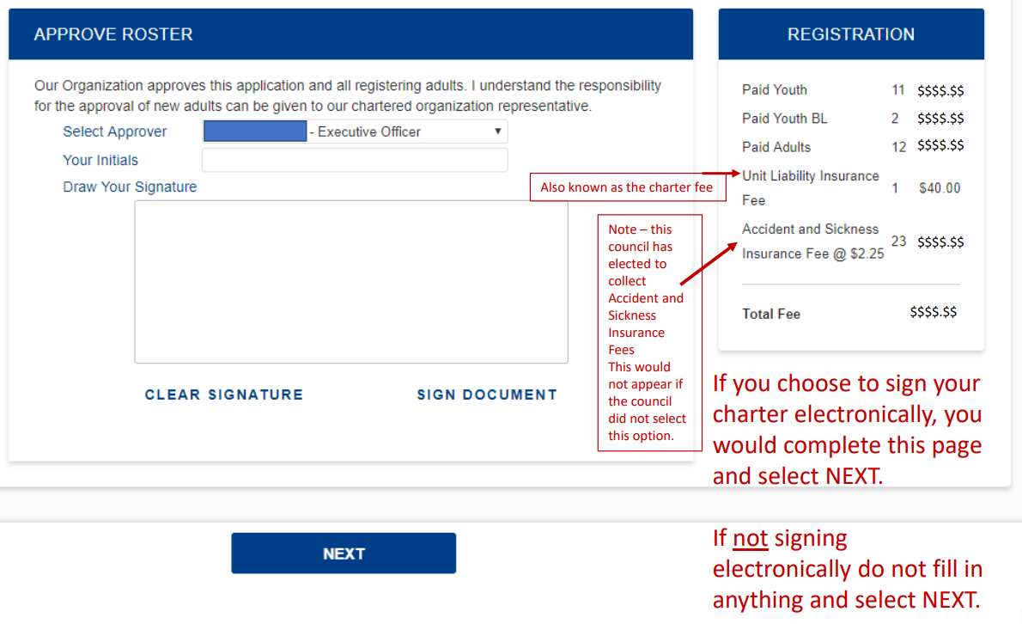
Electronic Approval Option & Total Fees
$5.00
Notes:
Your Executive Officer can digitally approve the re-charter, which can save you time as you will not need to track down his/her signature later. This is optional.
This page also shoes a fee summary.

Slide 21
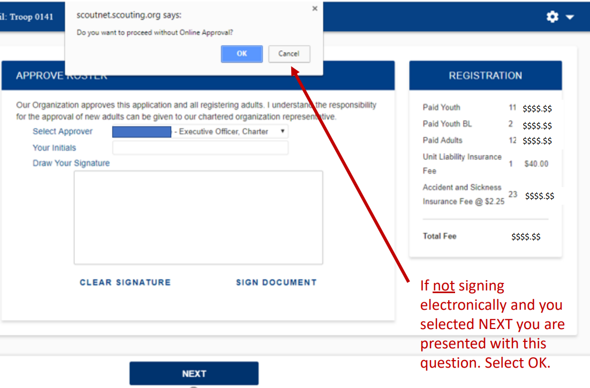
Non-Electronic Approval
$5.00
Notes:
If not signing electronically, simply click NEXT

Slide 22
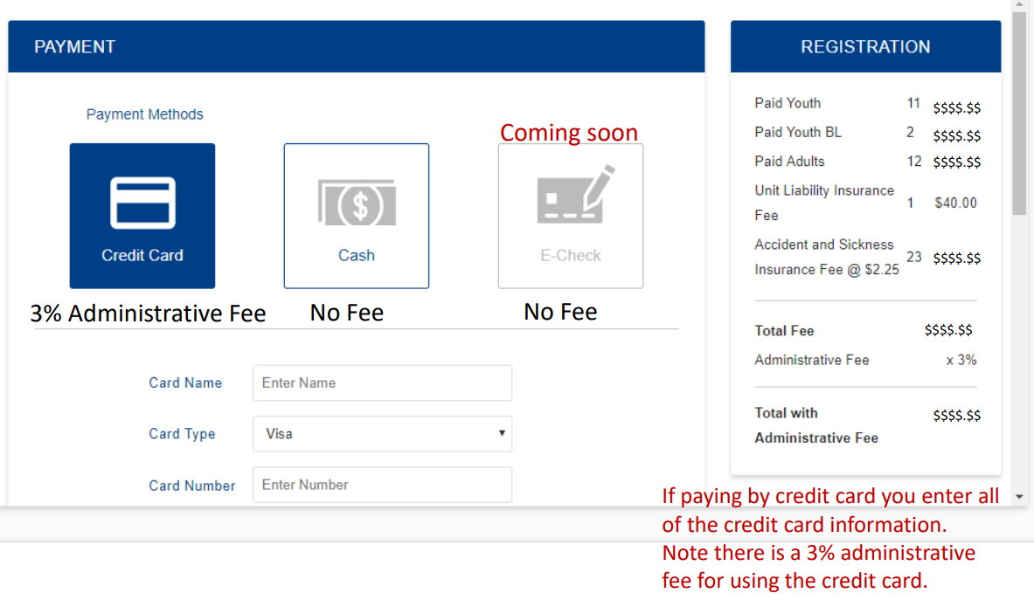
Payment Options
$5.00
Notes:
It will then take you to the payment options. You’ll have 3 options: Credit Card but it will charge you a 3% fee, Cash or E-Check.
Select Cash If:
- You are paying with a hard copy check that will be submitted with the paper recharter.
- You would like the Council to Charge your Unit account for the recharter. You will need to select this option on the next screen.

Slide 23
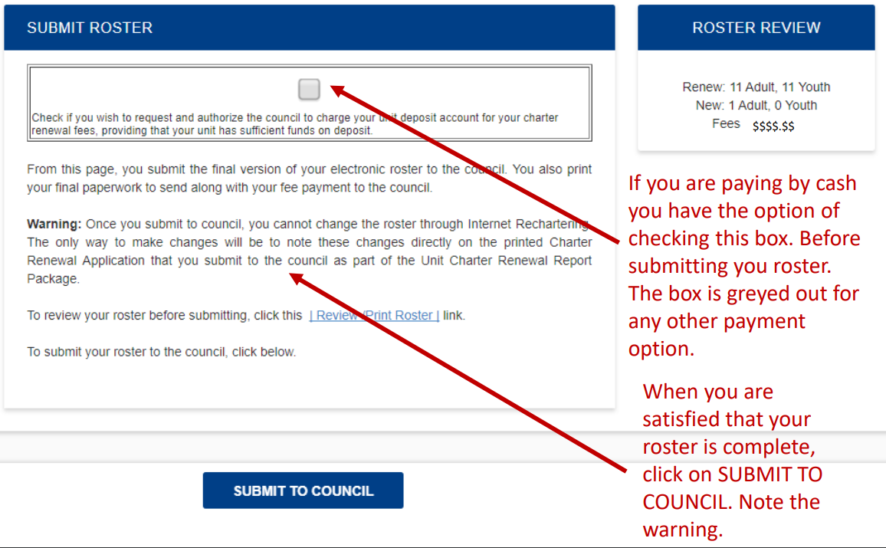
Click Submit to Council
Notes:
The last of the online steps, which should be completed by November 21st at the latest is to submit the re-charter to Council.
This will finalize the online portion of the re-charter.
If any changed need to be made after this is submitted, that’s ok. Simply print out the roster (next steps) and write on the re-charter what changes need to be made.
What happens after you submit?
Any applications that come across the front desk will be automatically added to your re-charter.

Slide 24
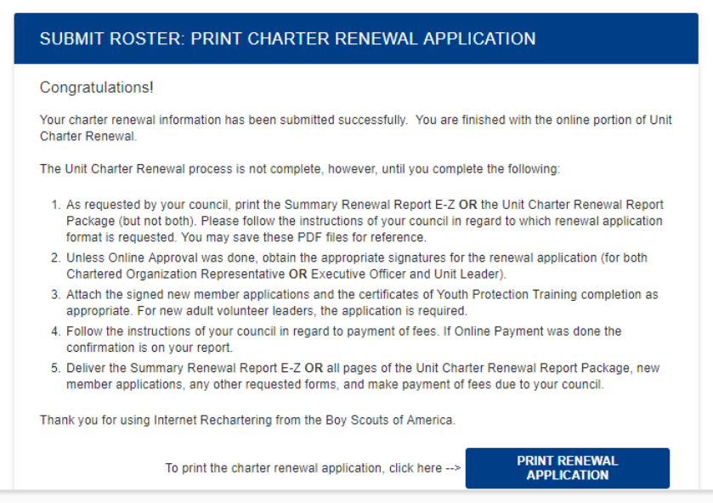
Print the Renewal Application
Select Unit Charter Renewal Report Package (NOT the E-Z Report)
Notes:
After submitting the roster, ALL UNITS must PRINT the renewal application and turn it in at the District Wild Beast Feast / December Roundtable.
This includes units that paid online and did an online signature.

Slide 25
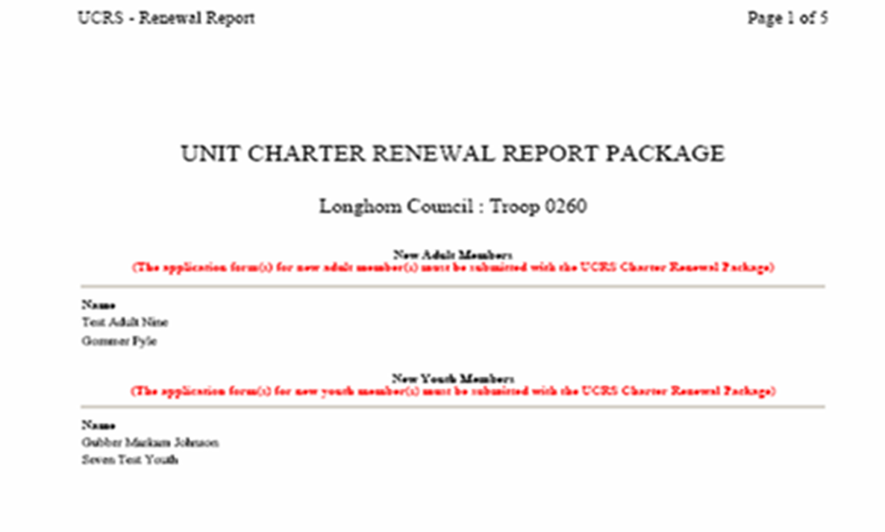
STEP 5: Obtain Signatures and Collect Missing Items
Any Items in RED on Front Page MUST be collected and submitted with the Re-charter
Notes:
After printing the re-charter, the unit must collect any items listed on the front page in RED such as Youth Applications / Adult Applications / Transfer applications etc.
If it’s listed on this page in RED then it must be attached or the charter cannot be processed. This means if the application was turned into the office already, it doesn’t matter, a hard copy of the application must be attached to the recharter paperwork.
On the 2nd page is where the signatures are needed. The Executive Officer of the Unit must sign this. If he/she digitally signed it, it will say that it was digitally signed. (see next slide)

Slide 26
Criminal Background Re-checks
In our efforts to better protect youth, beginning in 2020, the BSA will implement periodic criminal background checks on a five-year bases.
All currently registered adults must receive the new disclosures and authorization documents, and must submit, with the re-charter, a signed authorization form before the annual registration can be processed.
These forms are in your re-charter packets and can be found on our Council website.
Notes:
An e-mail was also sent to all currently registered adults with the forms.

Slide 27
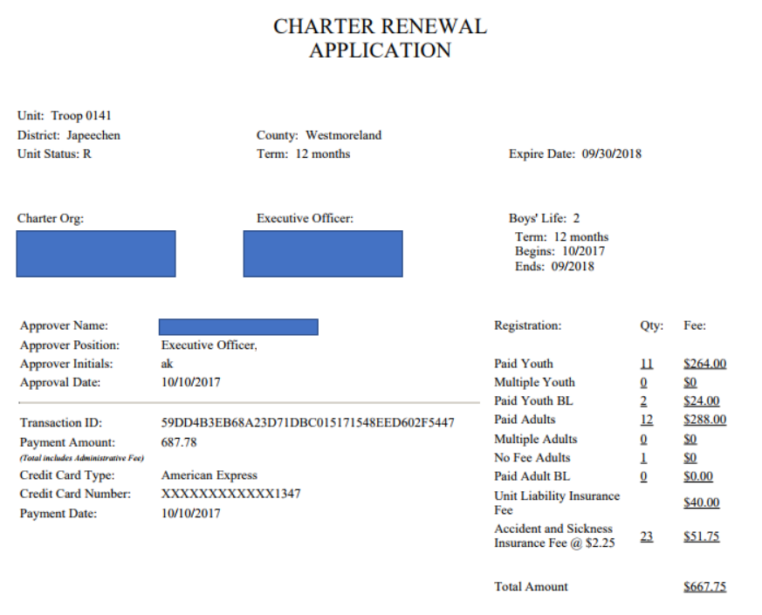
All Units MUST submit a paper copy of their Re-charter, even if they do electronic signature and pay online.
Electronic Receipt
Notes:
All Units MUST submit a paper copy of their Re-charter at the Beast Feast, otherwise we don’t know if they’ve done it or if it is missing anything. It’s a major flaw in National’s current system that causes many headaches.
In this example above: the Executive officer electronically signed this charter and the Unit paid online and they have a credit card receipt. No other signatures would be needed, the paperwork just needs to be turned in.

Slide 28
Tip #7: Utilize the Re-charter Turn-In Worksheet.
This will help you verify that the re-charter is error free and ready to be submitted to the Council office.
Tip #8: Your Unit Commissioner can HELP!
Meet with him/her to review your re-charter prior to the District Beast Feast.
Notes:
Make sure they know who their Unit Commissioner is! Their Unit Commissioners contact information should be given to them as part of the re-charter packet.

Slide 29
Step 6: Turn in Paperwork at:
The WILD BEAST FEAST!
Fun Social Event for Adults in the District!
Bring your entire Committee!
Bring “Beast” to Share with everyone
District Sub-Committee’s will have tables
Get your questions answered
Learn about the fun stuff happening next year!
Your District Beast Feast is:
Date & Time:
Location:
Notes:
Explain the District Wild Beast Feast or Chili event or other thing that your District does.
Be excited and tell them how much fun it will be!
Make sure to update the Date, Time and Location for your event.

Slide 30
Review of Key Dates:
Oct 1st – Online Re-Charter system opens
By Oct 31st – Complete Steps 1-2: Register & Review roster
By Nov 21st – Collect Fees, Submit the Recharter to Council.
By Dec 4th – Collect Missing Items, Obtain Signatures
and Review with a Unit Commissioner
Turn In Re-charter at your District Wild Beast Feast!
Notes:
Review the key dates and deadlines with them.
Explain that we want these done before the holidays as we don’t want to have to bug them to have to bug other people around Christmas.
Getting the re-charters turned in at your District Beast Feast is incredibly important, it gives us time to identify errors and fix things.
On January 1st, if the units recharter paperwork has not been received by our Council Office, insurance stops and the Unit must stop operating until the recharter is complete.
Re-charters may not be immediately processed on January 1st, but if the office has received your paperwork, than you have the green light to continue operating your Scouting Unit as usual.

Slide 31

Questions
Notes:
Thank everyone for attending and answer any question that the audience may have.

